Slide 1
Buddhism and Economics
In this course, we shall start with and discuss the following three topics:
What: in this part, we are going to talk about what is Buddhism and what is economics? In addition to that, what is the relation between those two?
How: then we are also going to discuss how can economics be understood in Buddhist perspective while how Buddhism can contribute to a better understanding of economics and betterment of economic condition, thus improving the overall wellbeing of people’s life;
Who: as the subtitle of the textbook suggests, our discussion would be always revolving around the central actors – people!

Slide 2
The what
Buddhism: a way of spiritual advancement, and it is characterized by its being otherworldly (i.e., spiritual advancement rather than material possessions) and asocial (individual practice in seclusion rather than social engagements), this stereotypical image of Buddhism shall be discussed with an open-mind;
Economics: studies of economic issues so as to find the best (most efficient) way improve people’s lives by distributing the scarce resources (materials or semi-material such as capital) in a community or society;
Buddhism and Economics: Convergence or divergence?

Slide 3
Starting point: the mantra
Om Mani Pad Me Hum!
The above is a mantra for the esoteric Buddhist practitioners who recited it as a way of spiritual improvement; but some people jokingly say that it also sounds as if all money be my home!
Despite the joke, the point here is that otherworldly does not mean not this worldly at all; asocial does not necessary mean not societal;
Please do remember, our monastic order, or Sangha, means community or harmonious group of bhikkhus and bhikkhunis; in a broad way, it also includes the laity whose supports are crucially important for the sustainability of the monastic Sangha;

Slide 4
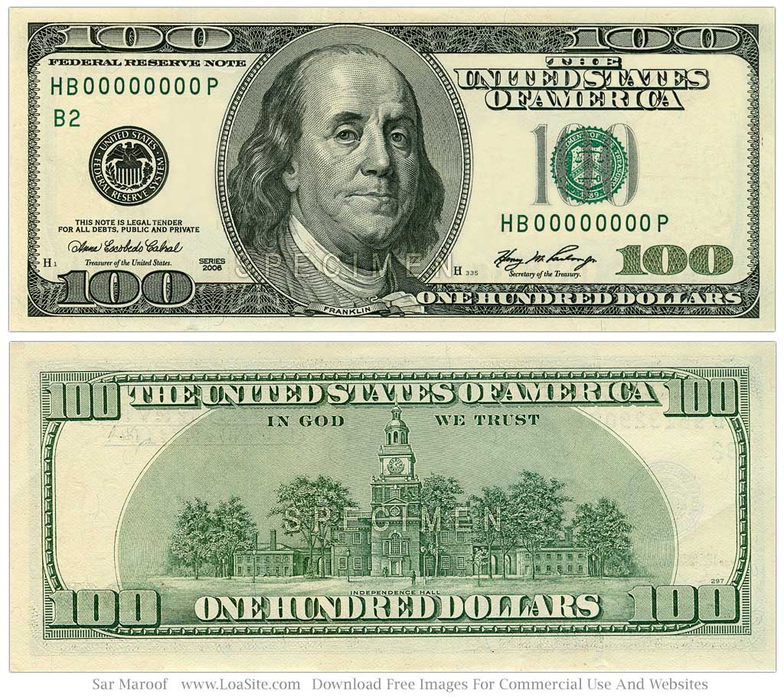
In God We Trust!
In God We Trust

Slide 5
Religion and economy or economy of religion?
We shall discuss this topic – economy of religion in due course but as you can see from the previous slide, even on the USD banknote (fiat money = legal currency of USA), we read In God We Trust!
I was told that on other banknotes too, such as Deutsche Mark (the banknote used in Germany before the current Euro), the word God is also printed on it;
So whether we are happy or not with the categorization of Buddhism as religion, its association with economy and study of economy – economics, can not be denied;

Slide 6
Buddhism and economics
As you know, Vinaya texts generally dealt with rules and procedures of the monastic Sangha; that was the stereotypical understanding until in the 1950s when scholars started to read Vinaya texts not as monastic rules but as sources of social history of Buddhism;
At least in most of the Vinaya texts of the different schools, there are sections dealing with the possessions of the Buddha, the Dhamma and the Sangha; so one point is readily obvious: if monks possess nothing apart from their daily necessities, how then those rules regarding material possessions were promulgated in the first place?

Slide 7
Basics of economics
Economics: study of the economy of a community, region or country; so what is economy?
Economy: if your answer is money, you are not far from the truth; indeed, in modern terms, economic activities can be summarized as money; in that sense, even the future of humanity is money because people buy stocks and bonds which in essence speculate the future ups and downs of their values; but there are other components of an economy such as GDP, resources, capitals etc.;
So perhaps in a nutshell, we remember that money is the platform whereby economic activities are conducted, such as buying and selling, voluntary exchange, and increase and decrease of money supplies etc.; we shall discuss more about the basic of economics in due course; for more detail, read the first few short chapters of the reference book;

Slide 8
Two tiers of understanding
Macroeconomics: the study of economic performance of a region, a country or large block such as Europe or Asia, and including issues such as inflation, unemployment and economic growth; so here the economists try to observe economic performance from up downwards; but something might be missing; so in a balanced way, economists would also have to look from down upwards – microeconomics;
Microeconomics: micro means small so this branch of economics is the study of economic behavior of householders (consumptions and savings) and firms (selling and profits) and the interaction between householders/firms and governmental policies;

Slide 9
Economics in a family
Let us see this way: Father needs to earn a living (wages or salary), so he “sells” his labor (he works for others) or capital (skills) in the market – factory, management, or workshops;
As a domestic manager, mother needs to be mindful about the distribution of the limited resources, such as money, among other things, so she needs to budget – distribution of money; in order to supplement the limited money, mother may save some money for the future – savings, and the bank would pay extra money for the savings because of the interest rate (always positive but not impossible of negative interest rate such as Japan’s central bank adjusted for a period of time) and probably other dividends – profits from the saved money; the deposit of money – saving – is just like a form of investment;

Slide 10
Economics
Mother may also lease an extra room (property) to others so that she could receive some rent as extra income; for all such economic activities, she needs to pay the proper tax;
Kids in the family want many tools and sweets, and they want new bicycles, new shoes and a new smartphone – their wants are unlimited; this cautions mother to be extra careful with limited resources! Mother therefore needs to have a well-planned budget because there is a budget constraint or budget line – balance between necessities and luxuries!
Even with necessities, there is a key word in mother’s mind whenever she considered her limited incomes: increase of price; in economic jargon, that is called inflation!

Slide 11
Opportunity cost
Because of the budget constraint, like all a businessman or an entrepreneur, mother is always sensitive toward economic incentives; for example, mother would buy daily necessities in wholesale package to save money – because wholesale usually gives more discounts;
In order to manage the household, mother may lose the opportunity of having a job – opportunity cost or the opportunity lost (the potential salary or wage); like mother in a family, almost everyone faces a choice amongst the available opportunities; generally we choose the best but that is not guaranteed; so economics is about how we make choice and the better one;

Slide 12
Trade-off, marginal analysis
What mother lost – opportunity – would be compensated by gains in other areas – professional housewife taking care of domestic affairs and children and benefits therein – which is called trade-off;
Because the parents decided father as a full-time bread-earner in the family, it is rational and beneficial for the family should mother be a professional housewife; but if the kids are old enough to take care of themselves, it might be a good idea for the mother to have a job – earn extra income;
All the effort of analysis is called marginal analysis (balance of marginal benefits and marginal cost – extra or additional benefits or cost);

Slide 13
Balance of resources and opportunities and making a choice
Trade-off: management of resources, cost and time etc.; for instance, if one spends a day in doing homework, or reading an important book, one’s hobby of watching TV needs to be sacrificed - trade-off (exchange of one thing for another)
Opportunity cost: loss of the highest value in order to achieve a necessary activity; the opportunity cost of being a professional student in BCS is the potential opportunities lost at your residential monastery such as promotion or monthly allowance; but in the long run, things might be different;

Slide 14
Economic incentive
Incentives: incentives sometimes are necessary, for without which people might waste more resources than they may actually need;
For example, it seems to be a habitual behavior that people would more often forget switch off the toilet lights in the working place or public bathroom; this would certainly happen less frequently in their own home, especially if the electricity is high in the domestic utility bills;
The reason is that with a limited budget (remember budget constrains) and the electricity is part of that budget, it would be beneficial to use as little electricity as possible;

Slide 15
Incentive: a story
With economic incentive, a story told by Cowen and Tabarrok is practically illuminating: In 1787, when the sea captains were hired to ship the convicted felons to Australia, many did not arrive at their destinations because the high mortality rates en route the sea; apart from diseases, they were badly treated by the crew on board; even prisoners’ food was forfeited and then sold for profits;
Then the government, at the advice of economists, changed the contract with the ship captains: instead of paying them in the UK, the captains would be paid in Australia; moreover, if the prisoners died before arrival, there would be no payment at all; so only six years later, in 1793, the survival rate increased to 99%; here, the incentive was simple: taking care of your customers – the prisoners, because they were the source of your income; (Cowen & Tabarrok, 2013:1)

Slide 16
Rationality
We make a decision after a certain amount of consideration, which is usually rational and reasonable; in this case, if one thing is good for me, it should be good for everyone because others are also considering their own position; nevertheless, rationality can also be misleading, for sociologically, rational sometimes means “a illusive reality” which is created out of popularity rather than rationality.
For instance, people might buy a new iPhone out of fashion rather than economic concern. Still, they are “rational” in the sense that they made the decision out of their own volition with their own money. Therefore the rational choice is also viewed as “purposeful behavior” – there is a desired and expected outcome at play.

Slide 17
The How and Who
How a topic of worldly concern such as economics can be studied together with a subject of otherworldly concern such as Buddhism? In fact, apart from the fact that Buddhism is every bit as concerned about wellbeing of people as economics, it is also true that Buddhism as a way of spiritual advancement, which would at the same time improve the overall wellbeing of our life – also the expected outcome of economics; this will be clearer during the course of our next few months of studies;
As to the question of who – or the people, it is important to note here that just like Buddhism, which is a way of people’s life, economics is also trying to understanding the economic behavior of individuals and economic performance of a region or a county so as to fix the potential problems, thereby improving people’s life;

Slide 18
Summary: facts check-1
Buddhism is primarily concerned about the spiritual aspect of human beings, although it never denied the importance of this world; after all, we are practicing Buddhism in this very world!
Economics is to study the economic behavior of individuals and economic performance of societies or countries; by such studies and a better understanding of economy, economics tries to fix the occurring and potential problems and make economy work for everyone in the society;

Slide 19
Facts check-2: Three key words are important
Resources or the access to resources are limited – scarce (scarcity), and this issue of scarcity is further complicated by the fact that people’s wants are unlimited, the first role of economics therefore is to understand all the issues caused by the scarcity of resources so as to provide a more efficient way of allocating those limited resources;
People are rational: this concept should be understood with caution, for people may or may not be rational but certainly not many are versed in or well informed about economics; so generally people are self-interested – they are rational in the sense that they want to get a better deal for themselves;
Incentive: due to the scarce resources and self-interestedness, people respond to incentive measures quickly and positively;
Any questions, please let me know via email;

Slide 20
Exercises
Do the following exercises and submit them via email (chuanqing@bcs.edu.sg) to me by 5:00 pm, on 9th September (Wednesday); please send the exercises of the two courses (Buddhism and Economics & Introduction to Buddhist Logic) together in one Word doc. file;
1, What is economic incentive? Can you give one example?
2, Generally, people are self-interested – they only think about their own welfare. Do you think this is true? Can you also briefly explain your answer.

